Slide 1
Automated Teller Machine
In Java
PRESENTED BY:
PEETH CHOWDHARY - 16010122034
DHRUV DESAI - 16010122038

Slide 2
BACKGROUND
In the modern banking landscape, Automated Teller Machines (ATMs) serve as essential self-service points for customers to conduct various financial transactions. A bank has recently implemented a new ATM system to cater to the needs of its customers. The system allows pre-existing bank customers to perform the following transactions:
Deposit Money: Customers can deposit funds into their bank accounts via the ATM.
Withdraw Money: Customers can withdraw funds from their bank accounts using the ATM.
View Transactions: Customers can view their transaction history to keep track of their financial activities.
Account Types:
The bank offers two types of accounts:
Current Account: This account type offers unlimited transactions and has no specific transaction limits. It is designed for customers who require easy access to their funds.
Savings Account: This account type has a maximum transaction limit. It is intended for customers who want to save money while still having some transaction flexibility.

Slide 3
PROBLEM STATEMENT
The goal of this project is to design and implement a class diagram for the ATM system that allows customers to interact with their bank accounts through the ATM.
The system should provide a user-friendly interface for customers to deposit, withdraw, and view transactions.
It should also enforce the account-specific transaction limits for savings accounts.

Slide 4
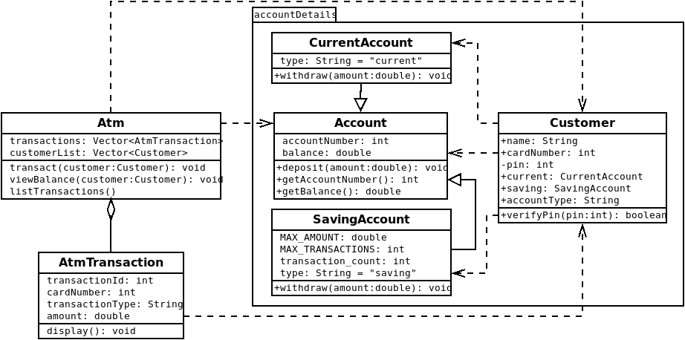

Slide 5
FEATURES
Inheritance: SavingAccount and CurrentAccount classes inherit from Account class.
Dependencies: The Atm and AtmTransaction classes are dependent on the Customer class while the Customer class is dependent on the Account, SavingAccount and CurrentAccount classes.
Aggregation: There is an aggregation relationship between Atm class and AtmTransaction class
Packages: The only user defined package in the clas diagram is accountDetails. It holds Customer, Account, SavingAccount and CurrentAccount classes.

Slide 6
IMPLEMENTATION DETAILS

Slide 7
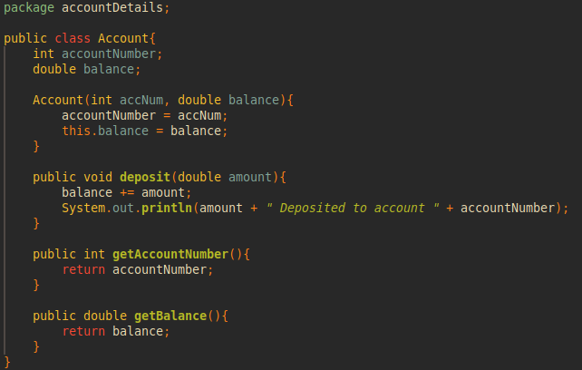
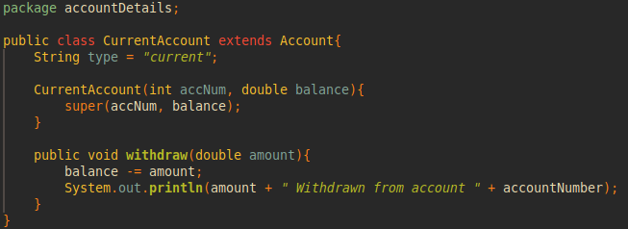

Slide 8
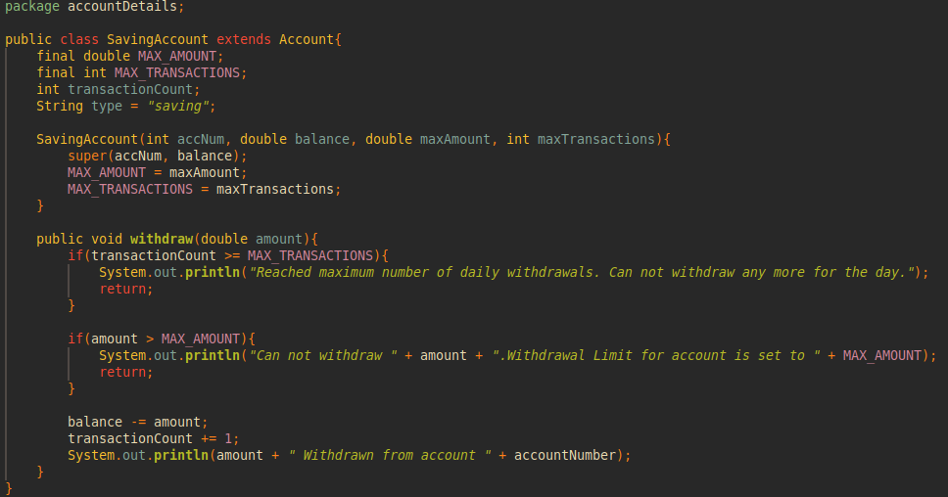

Slide 9
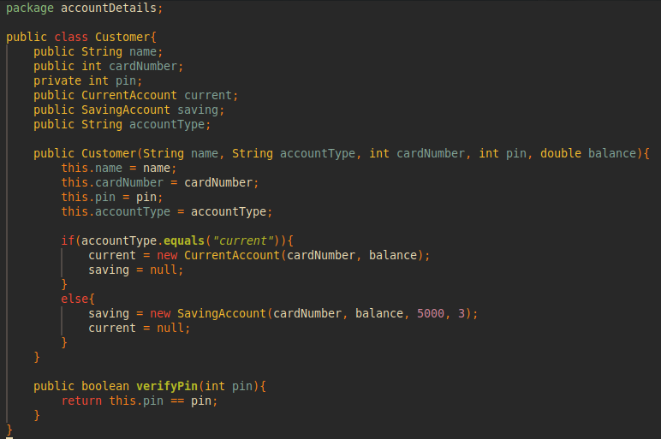

Slide 10
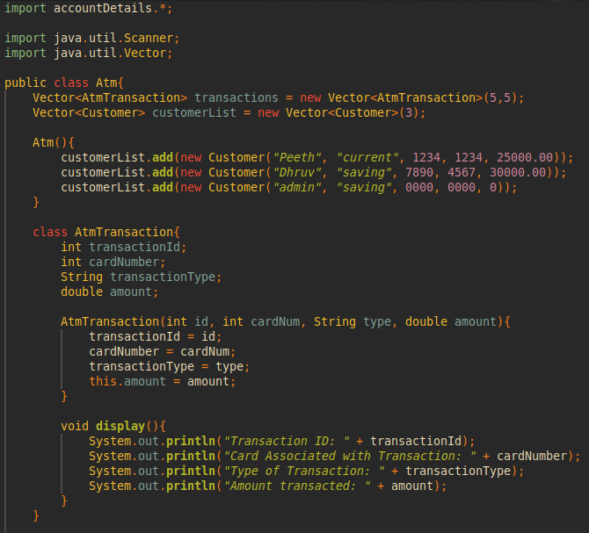

Slide 11
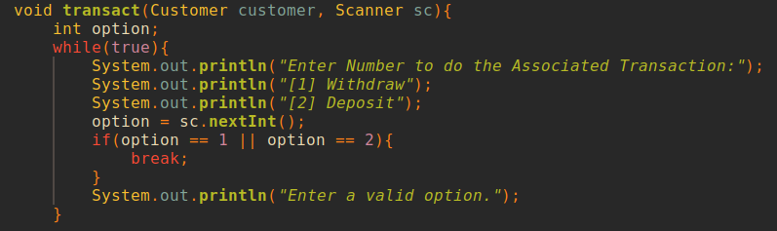

Slide 12
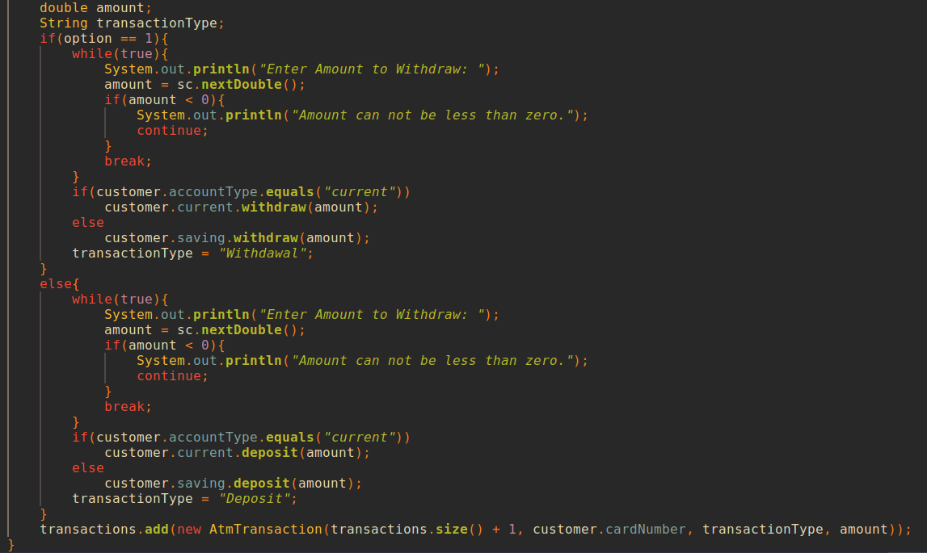

Slide 13
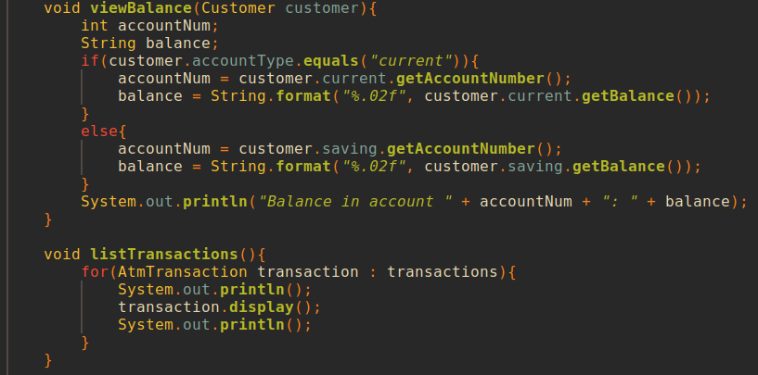

Slide 14
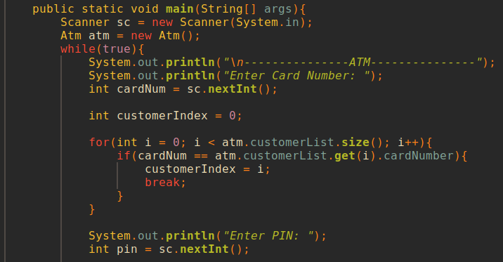

Slide 15
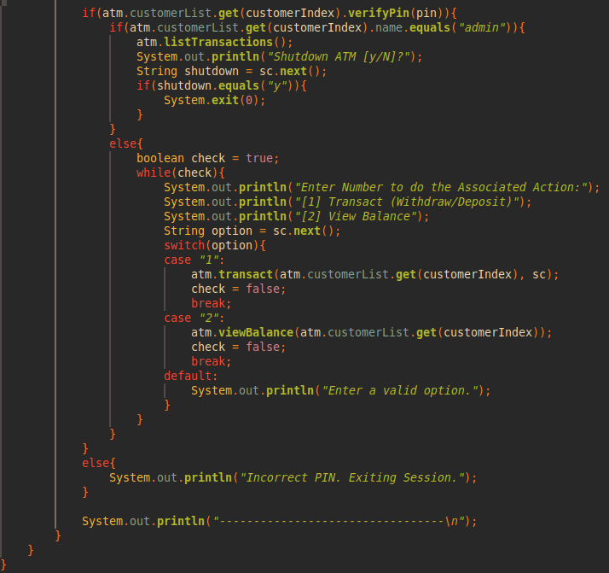

Slide 16
TEST CASES

Slide 17
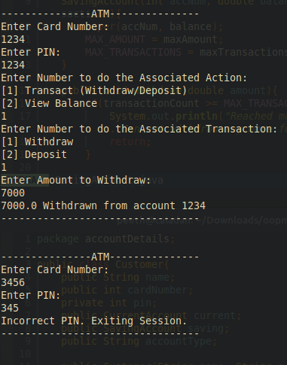
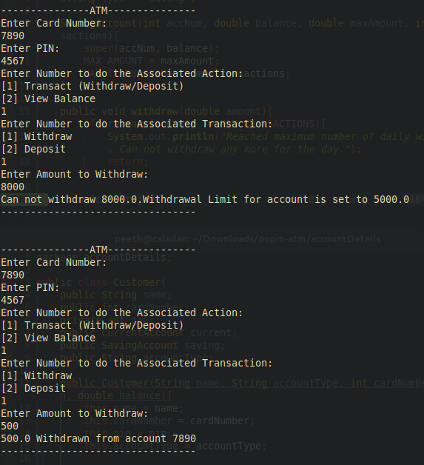
Test 3
Test 1
Test 4
Test 2

Slide 18
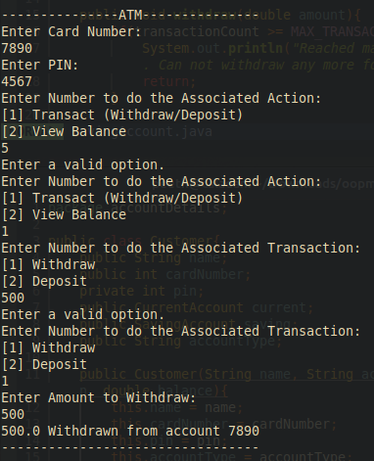
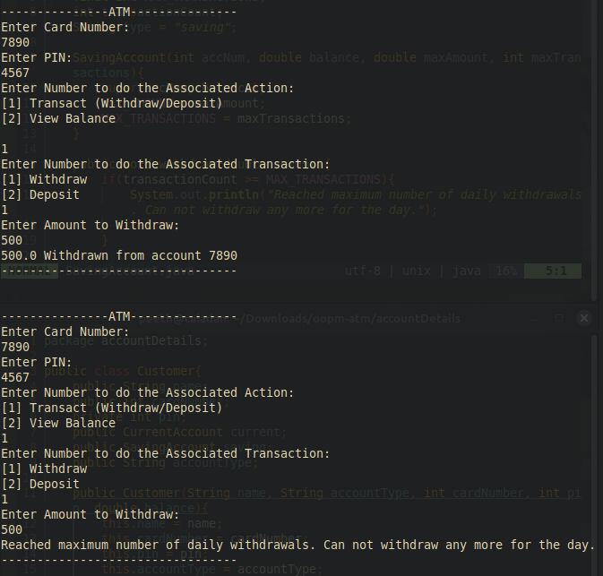
Test 4 Continued and Desired Result
Test 5

Slide 19
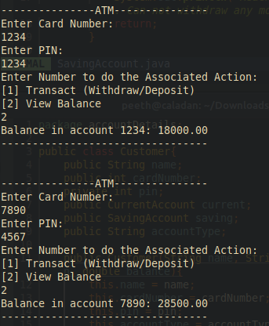
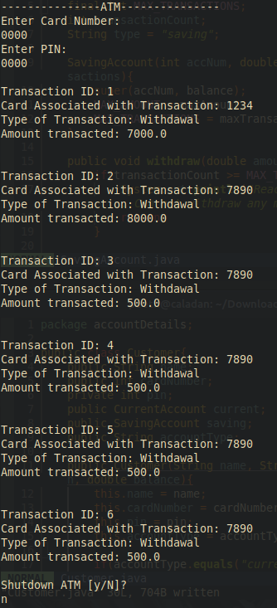
Test 6.
Test 7.

Slide 20
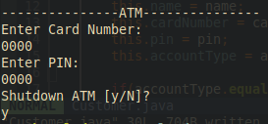
Test 8

Slide 21
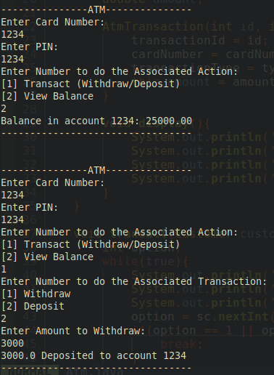
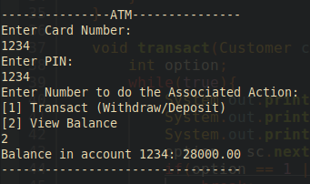
Test 9

Slide 22
LEARNING OUTCOMES
Creating a class diagram for an ATM system helped us better understand key Object-Oriented Programming (OOP) concepts as well as inbuilt functions, keywords and their proper utilization.
Abstraction: Simplifying a system by defining classes that represent real-world entities.
Encapsulation: Bundling data and methods within a class to preserving data integrity specially for the use case of the PINs associated with each ATM card.
Inheritance and Modularity: Creating relationships between classes, allowing one to inherit attributes and methods from another in a way that reduces the need to repeat the code we had written and, at the same time, increase the code’s efficiency and readability.
We also learnt how to better use vectors and attributes of objects with the help of a user defined package in classes outside the package we defined.

Slide 23
CONCLUSION
The successful implementation of the ATM system will provide bank customers with a convenient and secure way to manage their accounts, make deposits, withdraw money, and keep track of their financial transactions. It should ensure that all transactions are accurate and compliant with the account-specific limits, contributing to an enhanced customer experience while maintaining the bank's security and regulatory standards.
The designed class diagram will serve as the foundation for implementing this ATM system, allowing for the creation of the necessary classes, their relationships, and methods for efficient and secure customer transactions.

